Slide 1
Update on Microchannel Cooling
J. Daguin (CERN PH/DT)
A. Mapelli (CERN PH/DT)
M. Morel (CERN PH/ESE)
J. Noel (CERN PH/DT)
G. Nuessle (UCL)
P. Petagna (CERN PH/DT)
New process / design optimized for SFB
First test results from SFB wafer
Integration issues

Slide 2
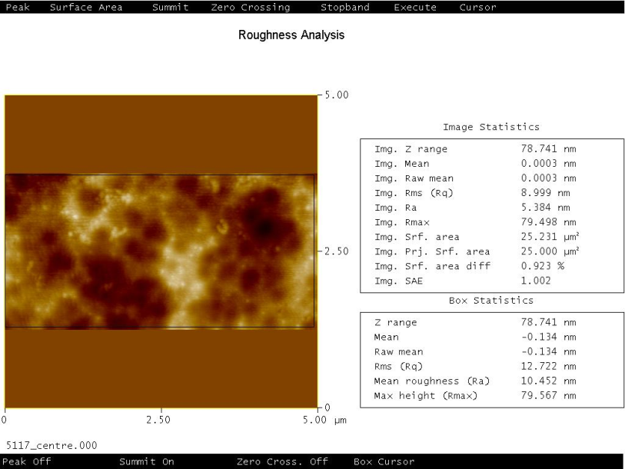
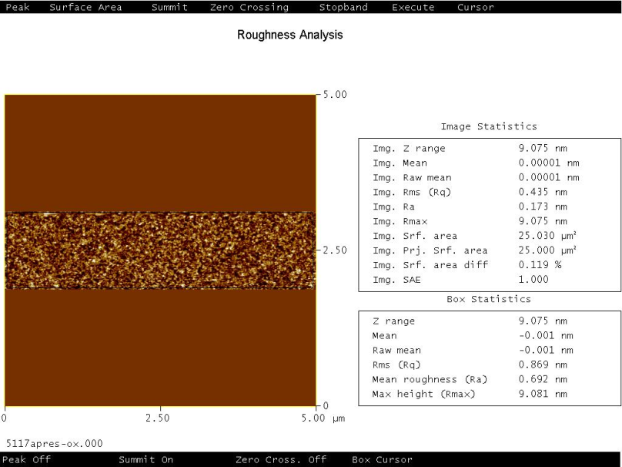
Problems Solved with Silicon Fusion Bonding
Problem #1: surface roughness and polymer contamination after DRIE process
Enhanced cleaning procedure
AFM Image of the surface BEFORE enhanced cleaning
(mean roughness ~ 10 nm)
AFM Image of the surface AFTER enhanced cleaning
(mean roughness < 0.7 nm)
Problem #2: bonding surface between channels too small
Modified design, wall thickness = 100 μm (used to be 25 μm for Anodic Bonding)

Slide 3
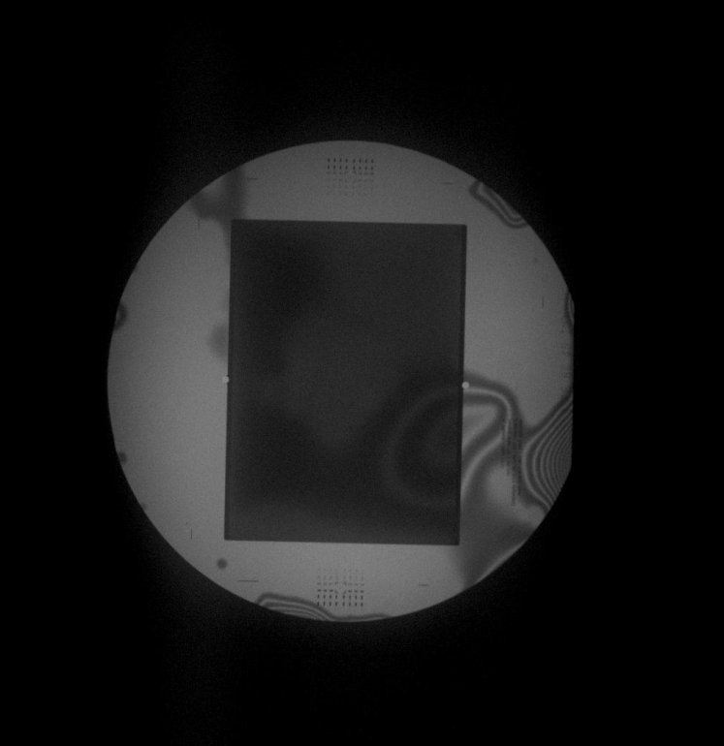
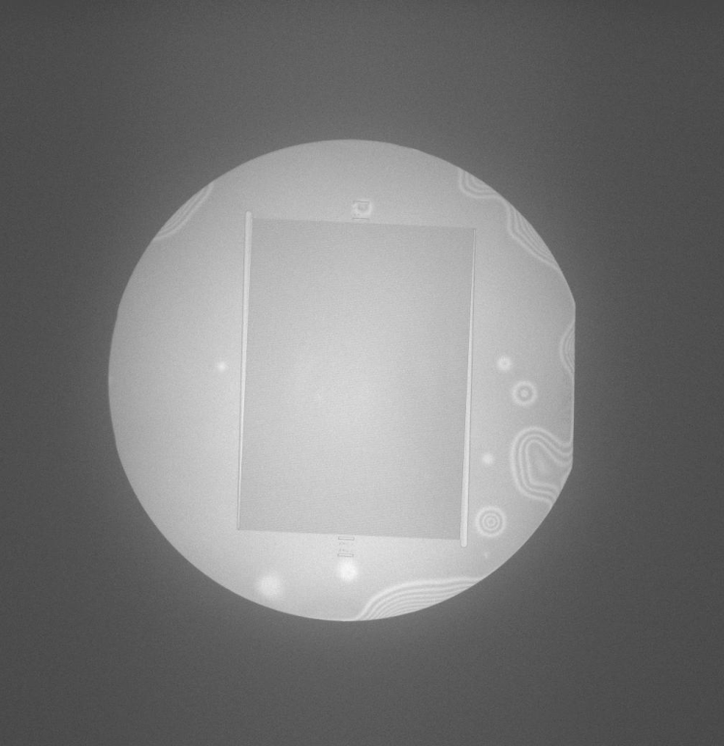
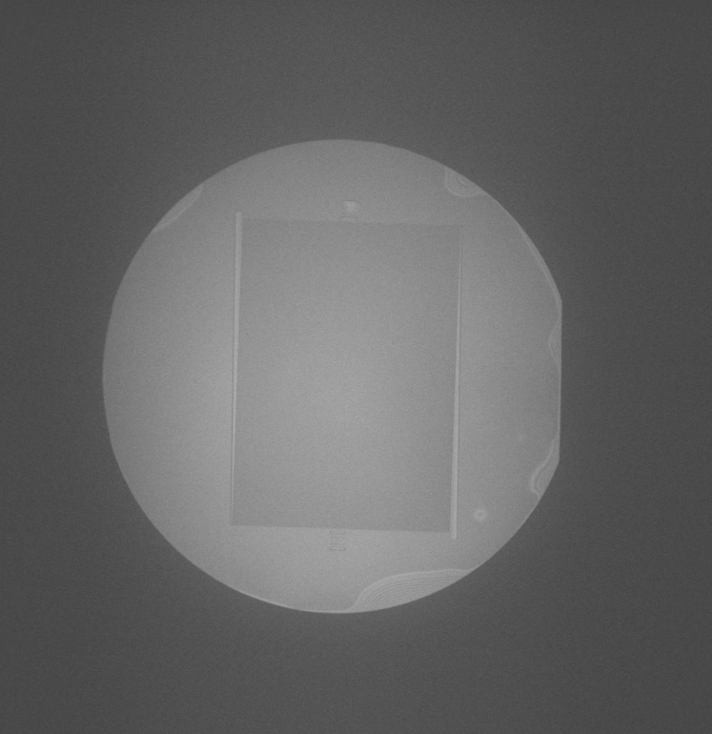
First Successful DRIE + SFB Cooling Wafer
IR image of a DRIE + SFB wafer with standard cleaning process
IR image of a DRIE + SFB wafer with enhanced cleaning process
IR image of a DRIE + SFB wafer with enhanced cleaning process + thermal annealing

Slide 4
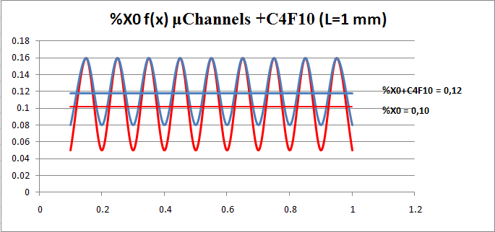
Expected X₀ Impact for the SFB Design
Channels:
100 x 100 μm or less
Readout chip
Si
Thickness =150 μm
C6F14
C6F14
%X0 = 0,1 % ÷ 0,12 % (with 150 μm of Si and channels of 100x100 μm)

Slide 5
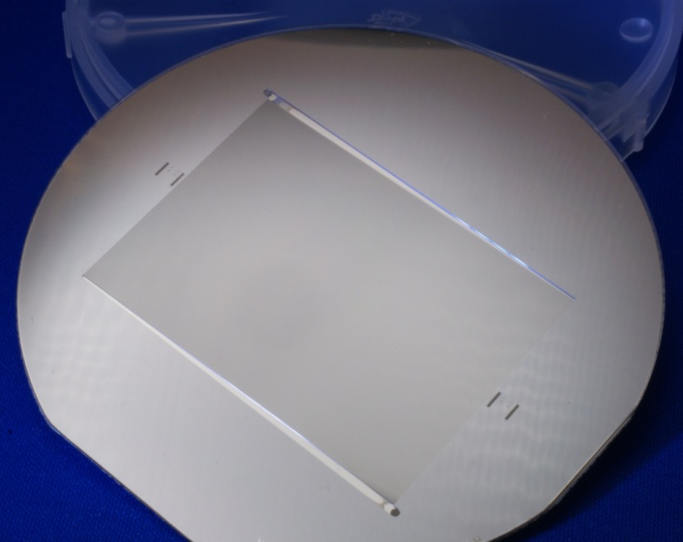
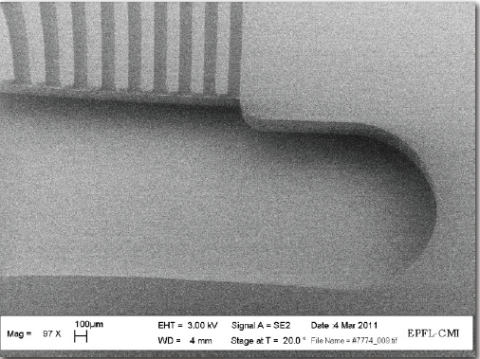
Frozen SFB Design for NA62 GTK
Manifolds 280 µm deep
Through holes
Channels 100 µm deep
Wall thickness between channels: 100μm (optimized for SFB)

Slide 6
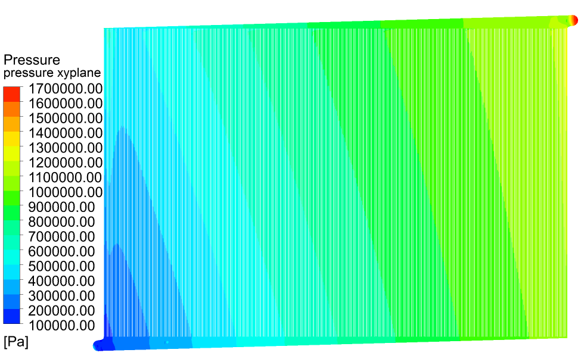
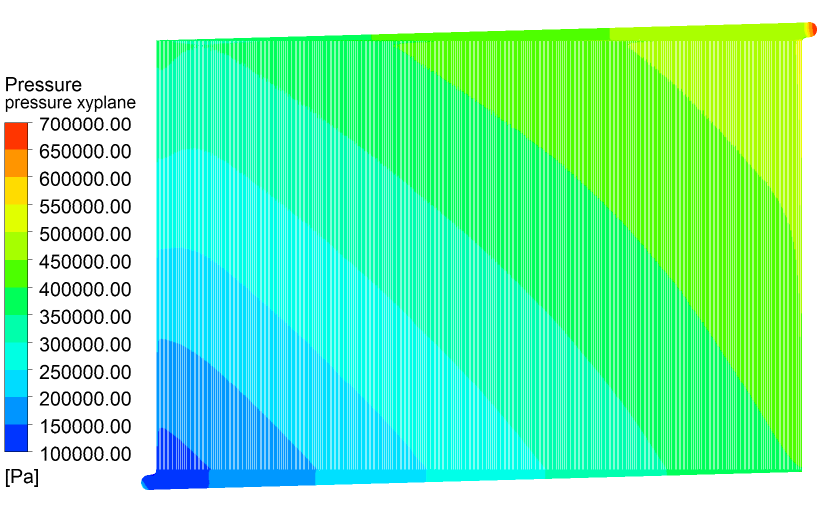
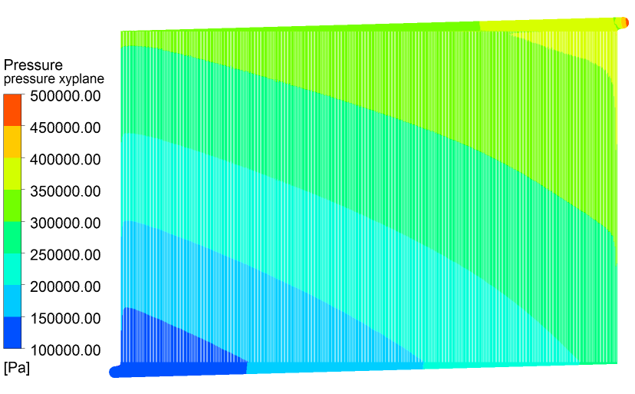
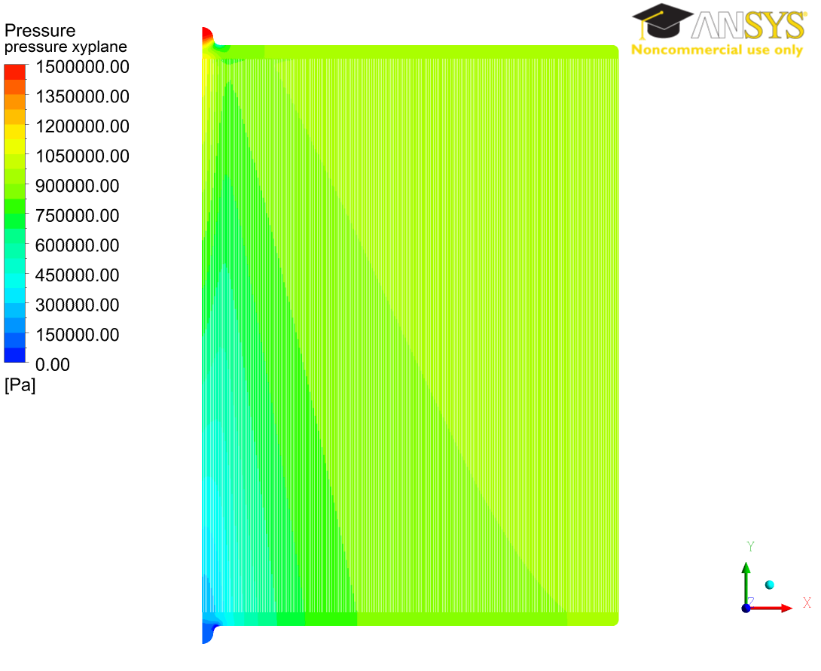
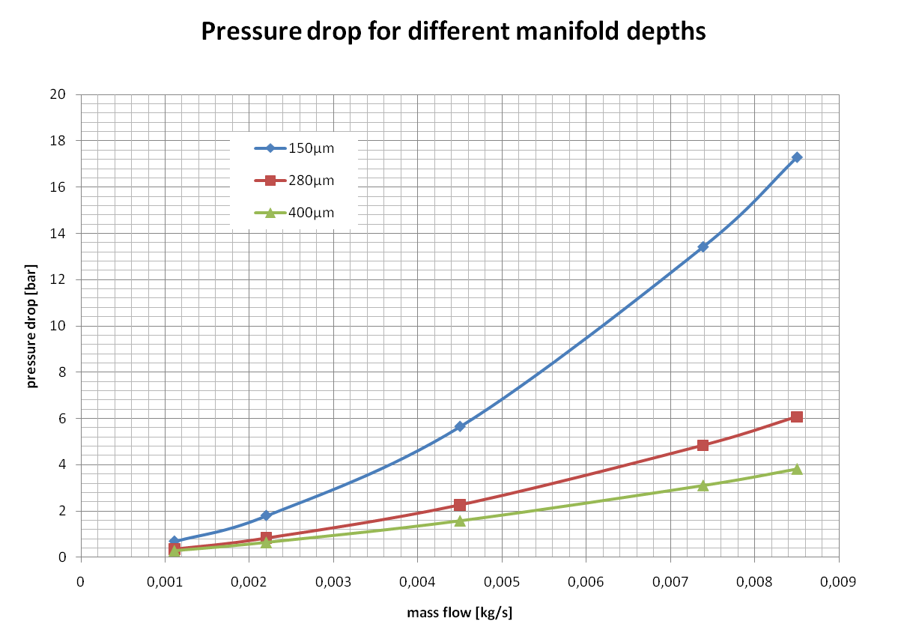
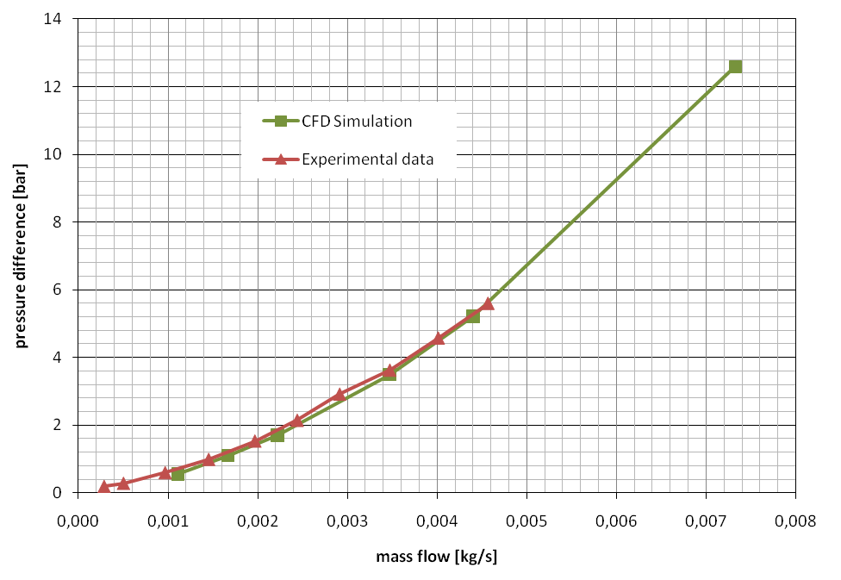
Calculated Effect of Manifold Geometry on Pressure
Initial design: simulation vs. measurement
Design optimization
Wedged manifold, 1.6 mm Max width, 150 μm thick
Wedged manifold, 1.6 mm Max width, 280 μm thick
Wedged manifold, 1.6 mm Max width, 400 μm thick
Rectangular manifold, 1 mm wide, 100 μm thick, central inlet & outlet

Slide 7
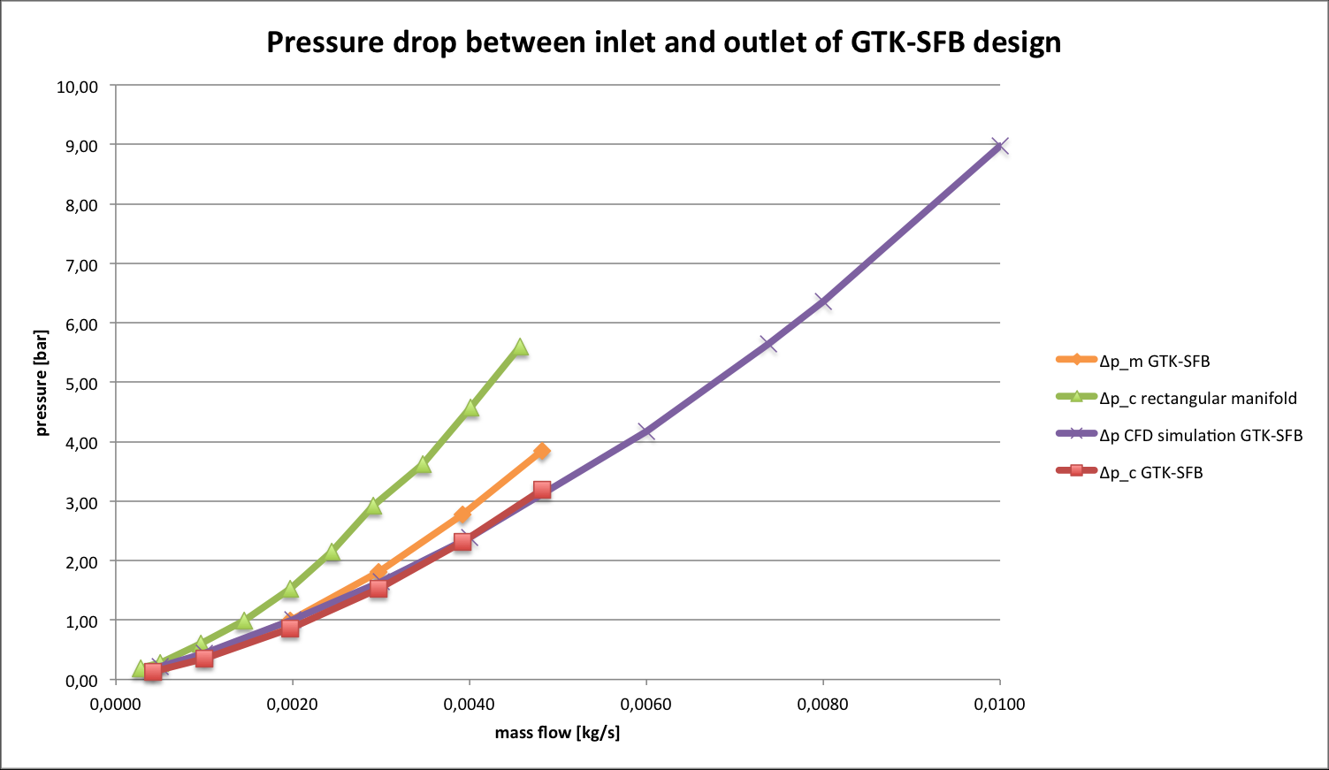
Measured Pressure Drops for New Design
Nominal flow rate for ΔT~5 °C with P=48 W

Slide 8
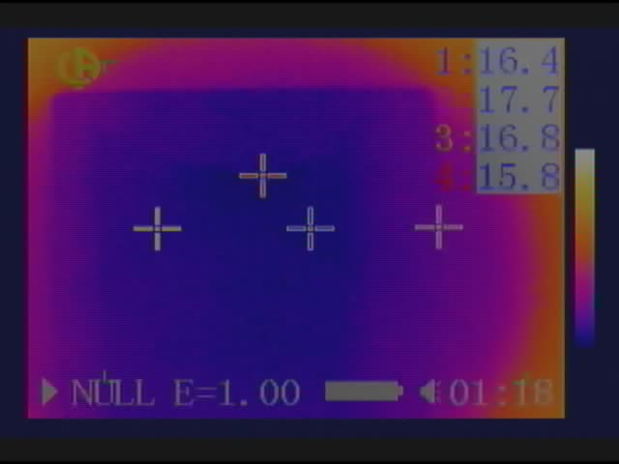
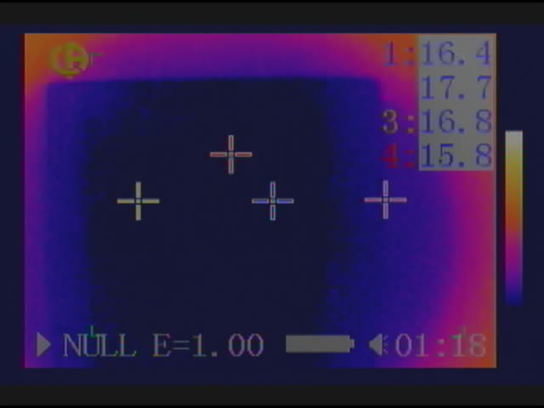
Flow Distribution with New Design
Preliminary test to “visualize” the level of uniformity of the flow inside the cold plate: while circulating, the temperature of the fluid is progressively reduced below the lower threshold set for the thermal camera. As soon as the fluid reaches that temperature, the whole surface of the cold plate passes below the threshold in one go.
OUT
OUT
T_{fluid} passes below the lower set sensitivity of the camera
IN
IN

Slide 9
“Visualization” of Flow Distribution: MOVIE
http://petagna.web.cern.ch/petagna/gtk%20movie/

Slide 10
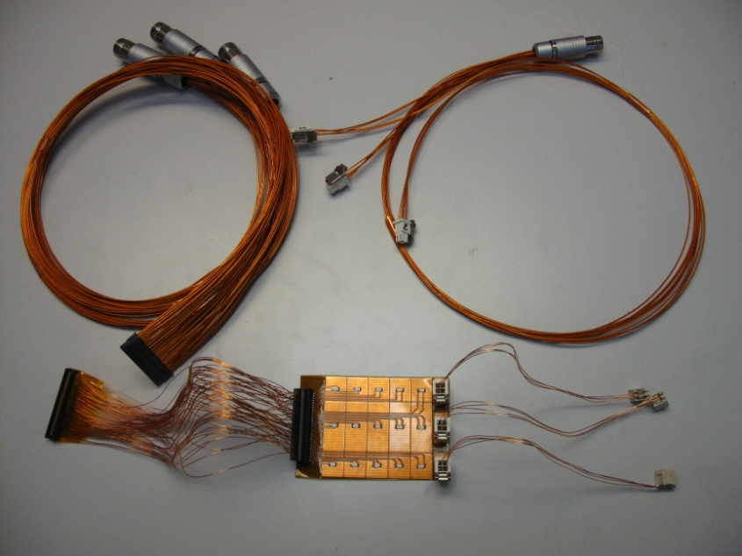
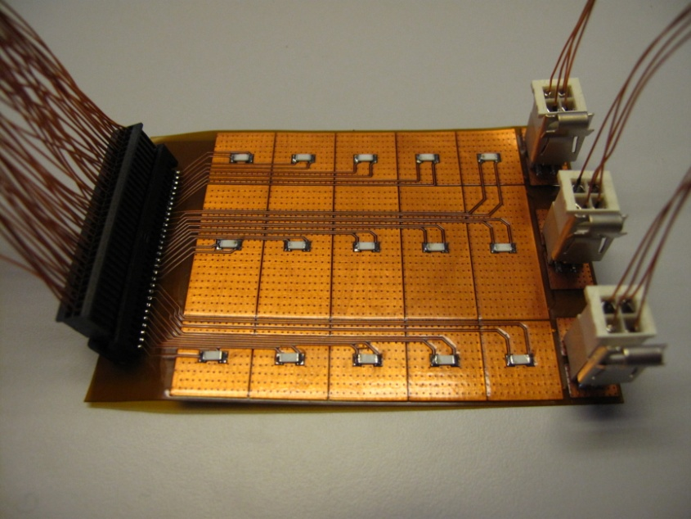
The New “GTKsym” Heater
Design: M. Morel
Production: R. De Oliveira

Slide 11
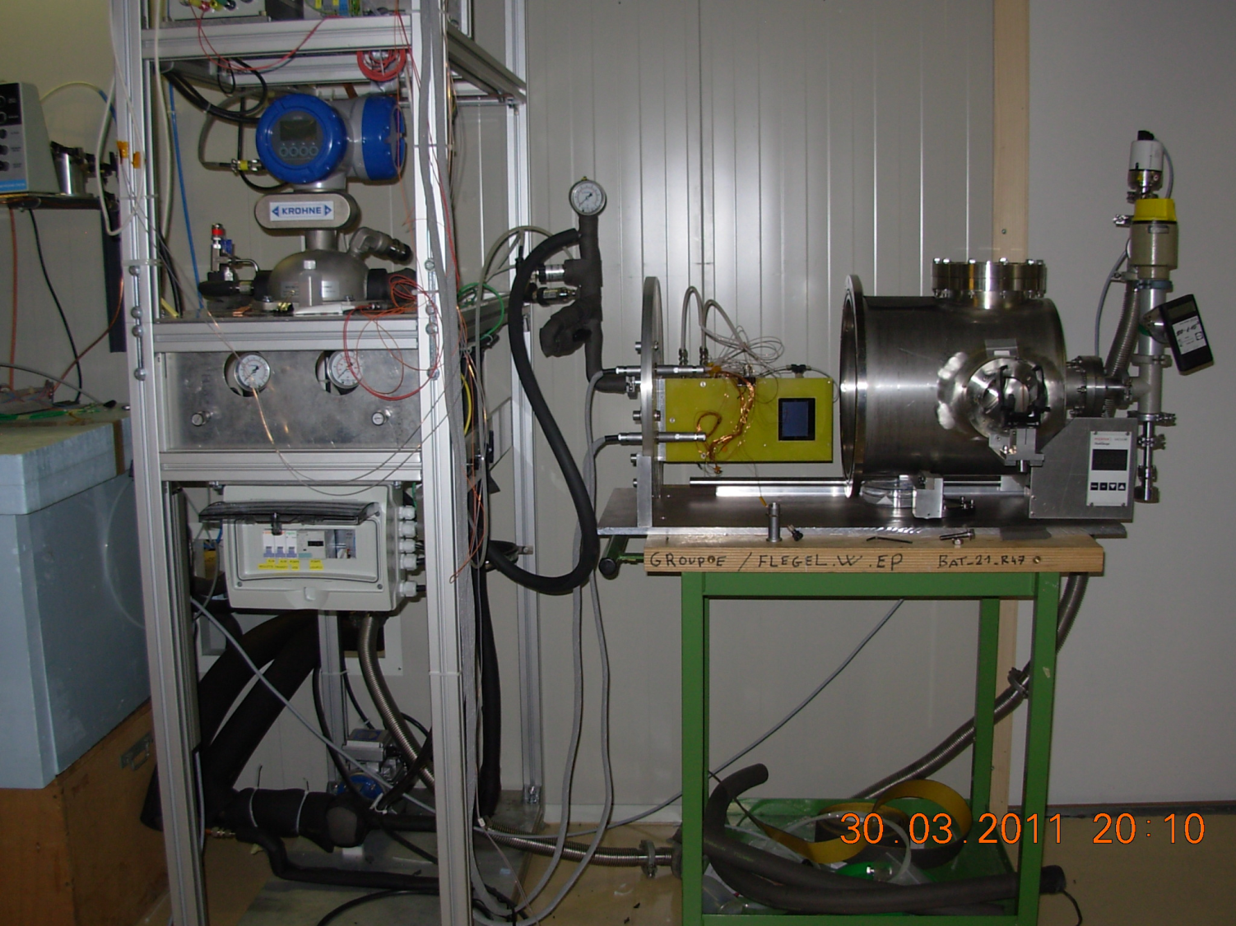
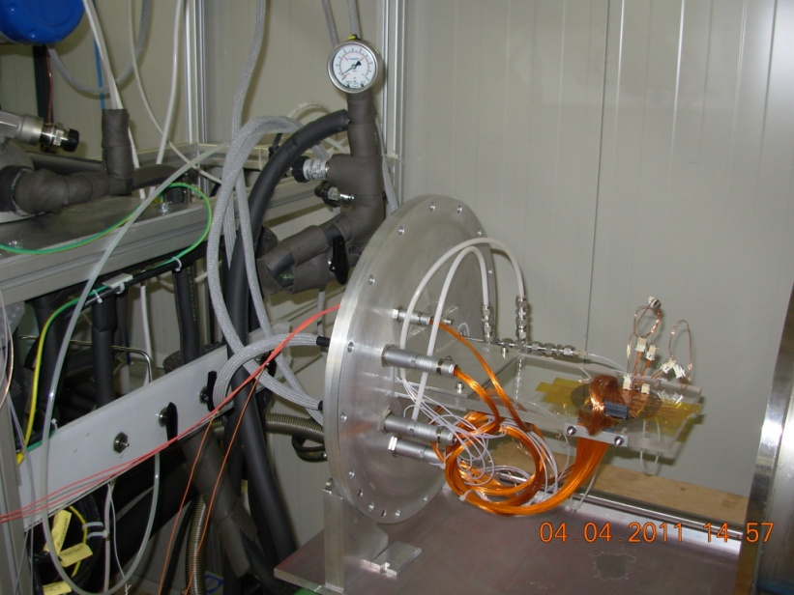
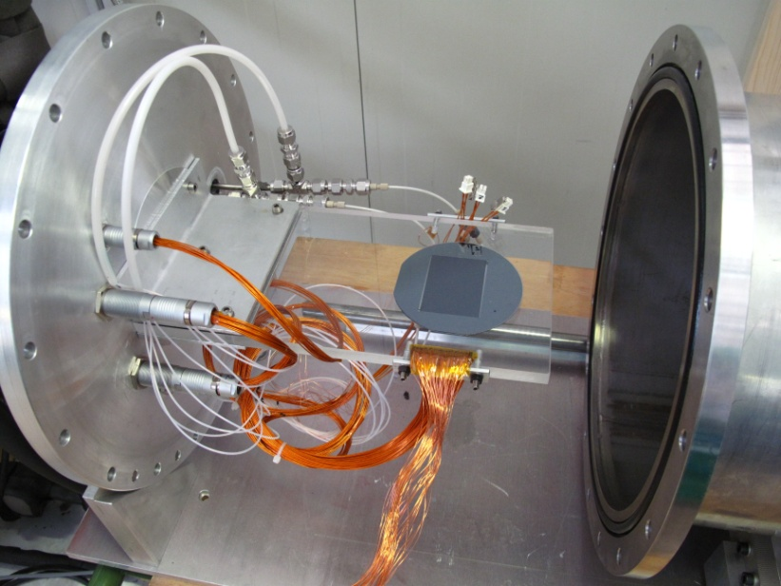
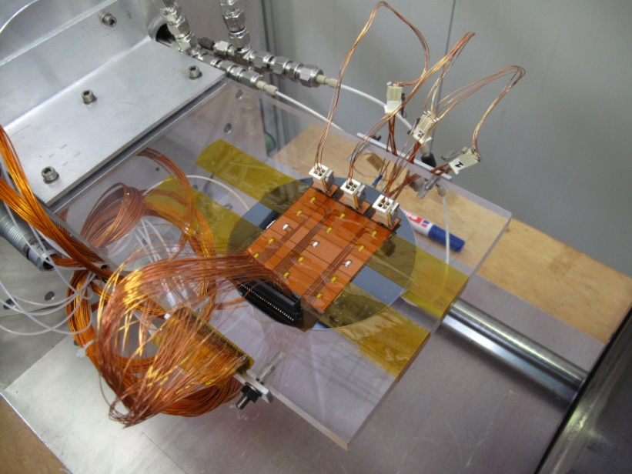
GTK SFB Design under Test

Slide 12
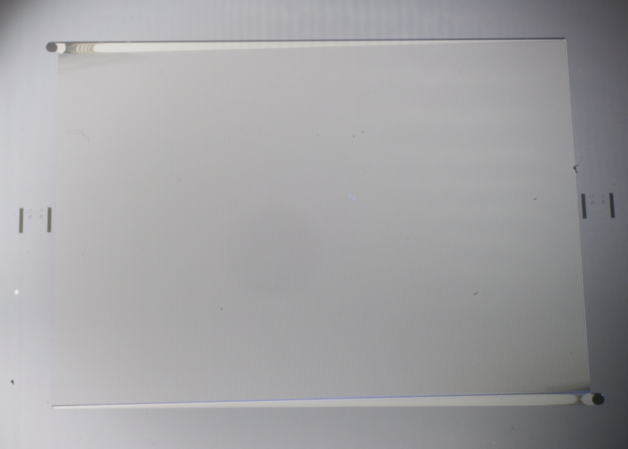
Very First SFB Design Heating Test
FLOW IN
Test under mild vacuum (2 ·10⁻² mbar)
No detectable leak
P = 16 W (½ nominal)
Q = 0.0036 kg/s (½ nominal)
ΔT_{IN-OUT} ~ 3.5 °C
HEATING SURFACE
FLOW OUT

Slide 13
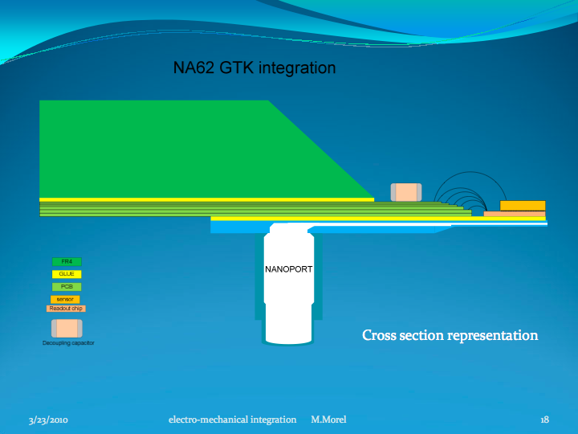
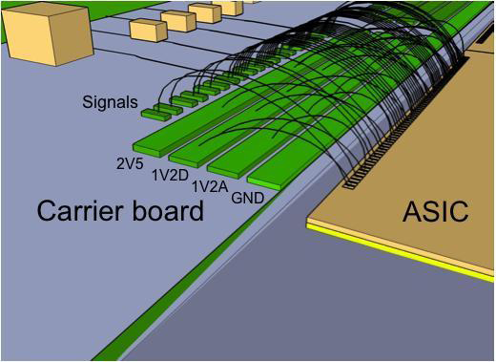
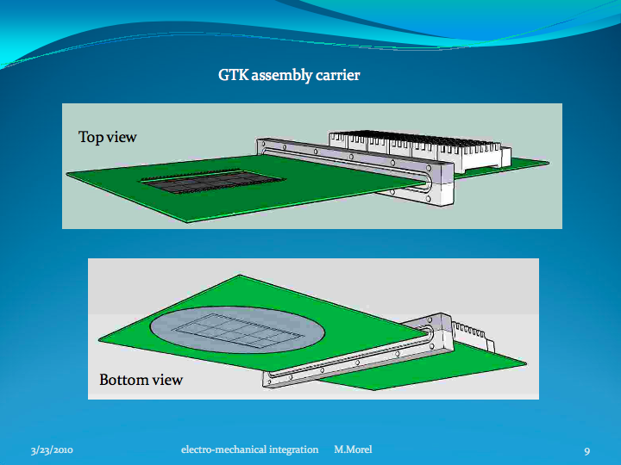
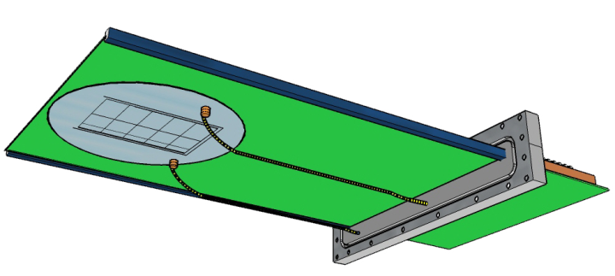
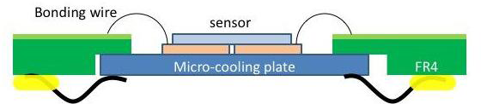
Integration in the NA62 GTK module
A test programme of the integration between cooling plate, sensor and readout chips has been started and will cover the following issues: choice of the bonding material, the handling of objects and the design of the mechanical supports.
M. Morel, A. Honma and I. McGill involved.

Slide 14
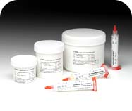
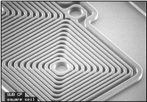
Spin-coatable Adhesives Pre-selected
Staystik:
http://www.cooksonsemi.com/products/polymer/staystik.asp
SU8
http://www.microchem.com/products/su_eight.htm

Slide 15
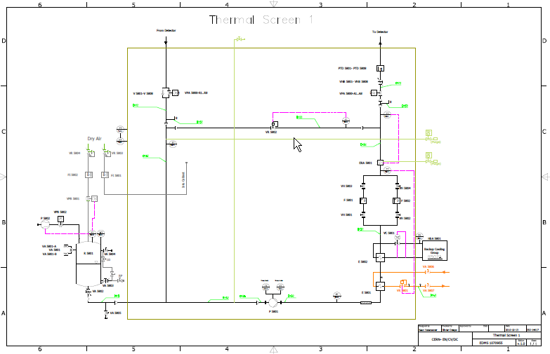
Basic Ideas about the Cooling Plant(s)
Standard design and components in use in several LHC experiments (EN/CV-DC)
Option A: 3 local small units (~15 kCHF each)
Option B: 1 larger unit with long transfer lines

Slide 16
RESERVE SLIDES
?

Slide 17
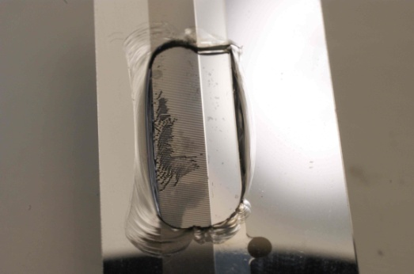
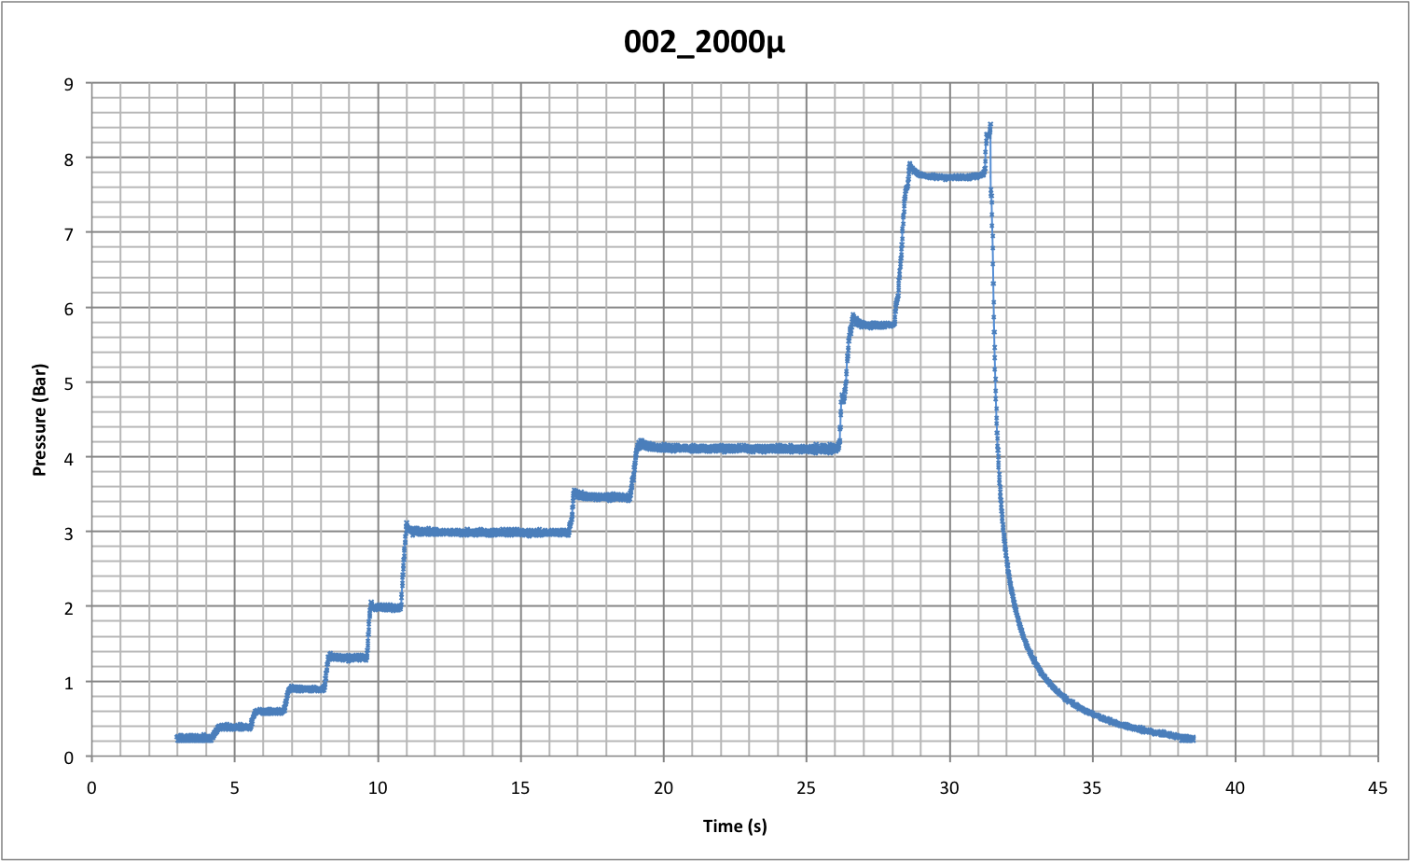
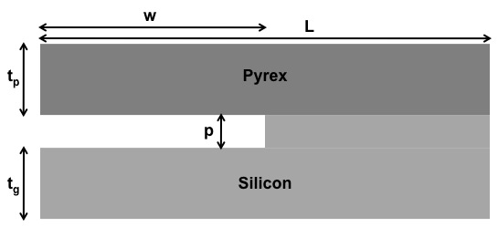
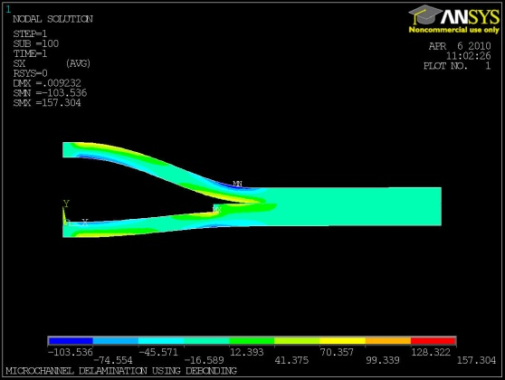
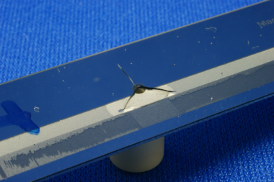
Pressure resistance vs. channel dimension
RESERVE SLIDE

Slide 18

Radiation Length Values
Radiation length (X₀): mean distance over which the energy of a high-energy electron is reduced to 1/e (0.37) by bremsstrahlung
(Dahl, PDG)
Cu: 1.436 cm
Steel: ~1.7 cm
Al alloy: ~8.9 cm
Ti: 3.56 cm
Si: 9.37 cm
K13D2U (70% vf): 23 cm
PEEK: 31.9 cm
C₆F₁₄ @ -20 °C : 19.31 cm
C₃F₈(liquid) @ -20 °C : 22.21 cm
CO₂(liquid) @ -20 °C: 35.84 cm
RESERVE SLIDE
More readily usable quantity: X₀ = X₀/ρ [cm]

